Slide 1
Phylogenetics: Nextstrain
EMD 531
Lecture 9
nathan grubaugh, phd

Slide 2
Learning objectives
Students will be able to:
Discuss how Nextstrain promotes rapid genomic data dissemination for outbreak monitoring
Understand the core components for Nextstrain tree building and visualization.
Construct a Nextstrain “community” page
Start Exercise #4: Interactive phylogenetics using Nextstrain
Reminders for data formatting for Class 10 (Nextstrain part 2)

Slide 3
What is Nextstrain?

Slide 4
Motivation
Speed: Rapid genomic analysis and dissemination for public health interventions
Current publishing practices are too slow!
Ease: Intuitive design to easily discover and highlight important findings
Community: Open-source tools to promote independent growth

Slide 5
Nextstrain today
Bioinformatic pipeline (augur) and visualization tool (auspice)
Main website integrates public data via automated or manual functions
Continuously updated
Genomic and non-genomic metadata
Source code copied many times over to create independent analysis platforms
Non-public or unpublished data
Learn how to use the functions:
https://neherlab.org/201901_krisp_auspice.html

Slide 6
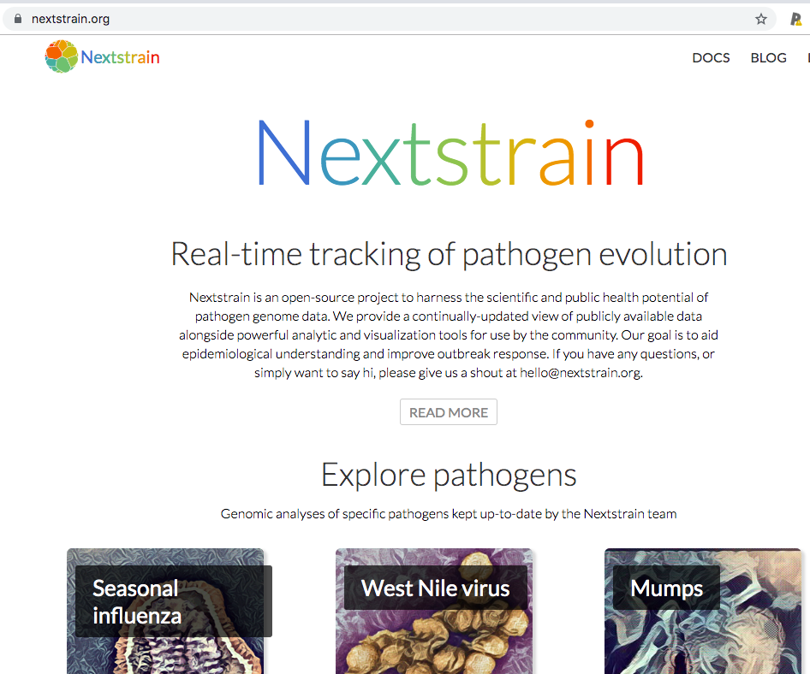
Nextstrain.org

Slide 7
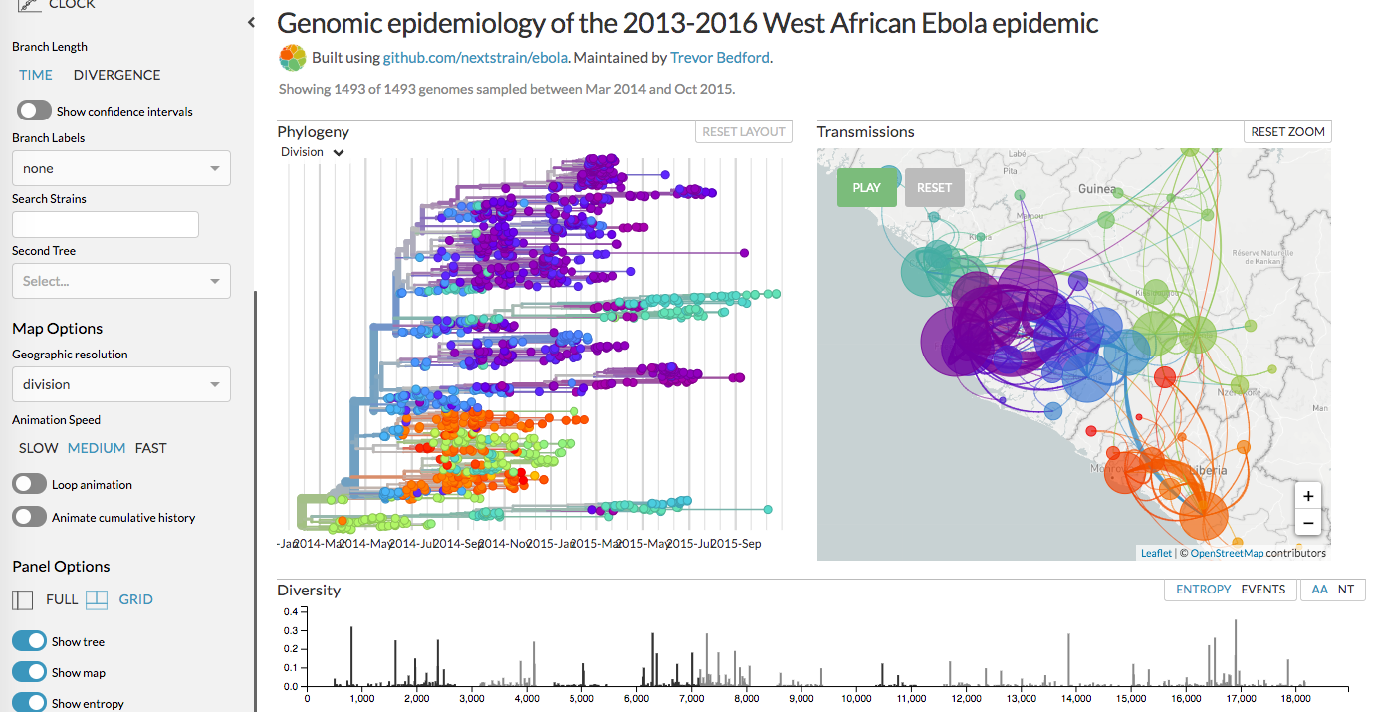
West Africa Ebola 2013-16

Slide 8
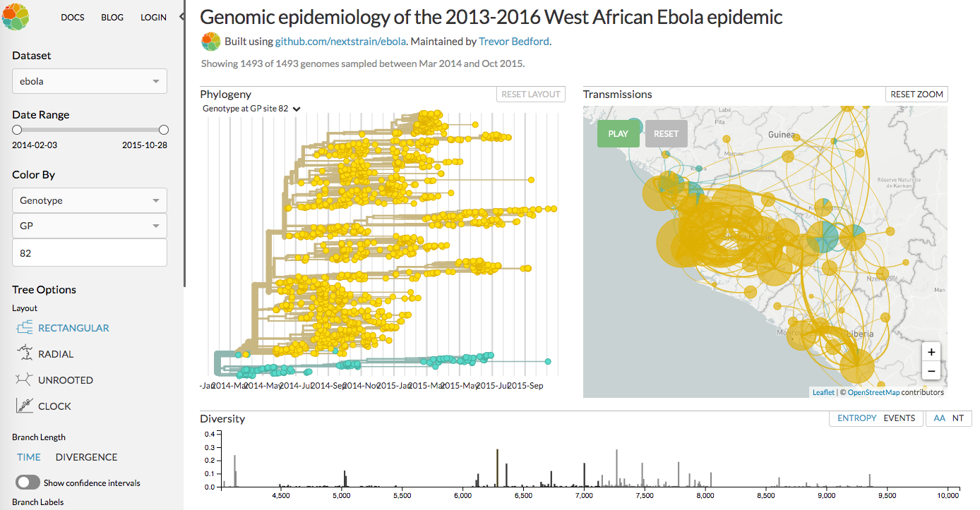
West Africa Ebola 2013-16

Slide 9
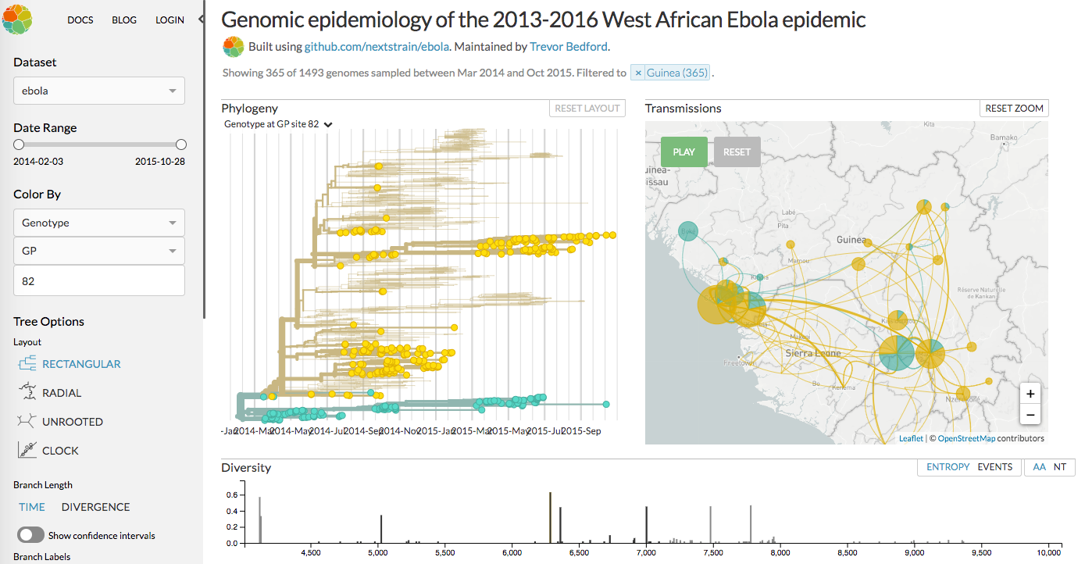
West Africa Ebola 2013-16

Slide 10
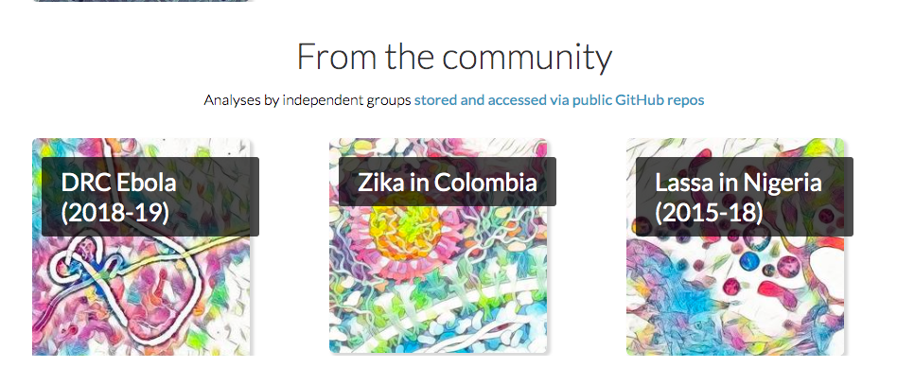
Community builds
Local installation of augur and auspice
Private and public data > local analysis
User has complete control > shared only if wanted
Data can be protected
Advantage > Speed, no go-between to get results online!

Slide 11
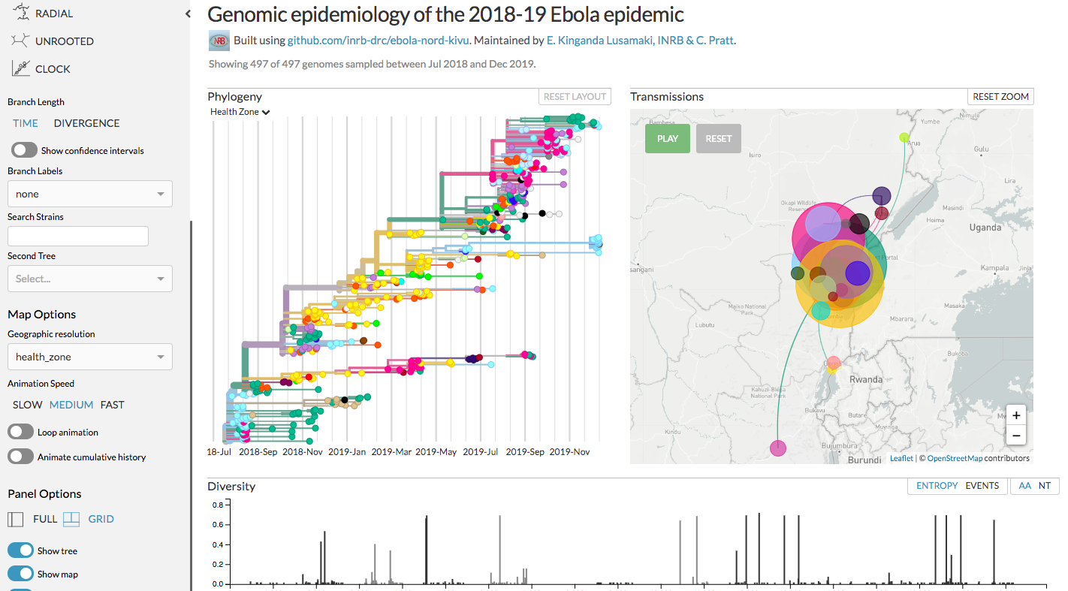
DRC Ebola (2018-19)

Slide 12
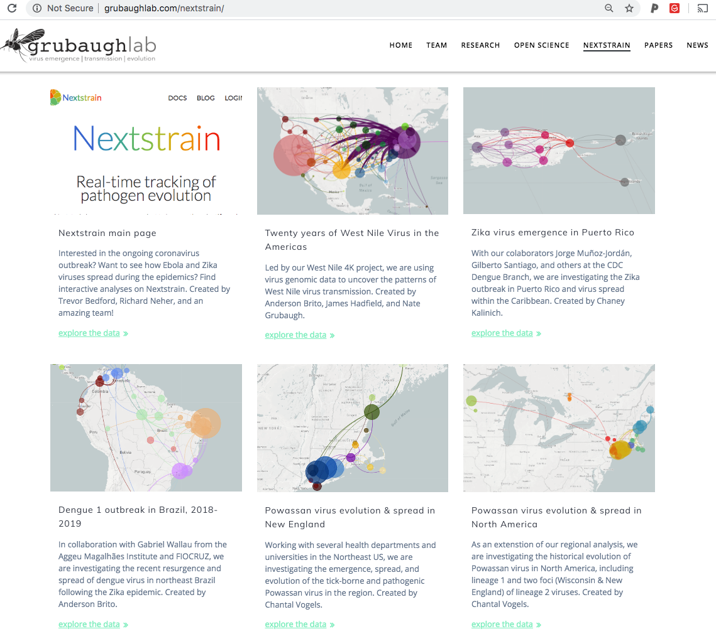
Grubaughlab.com/nextstrain

Slide 13
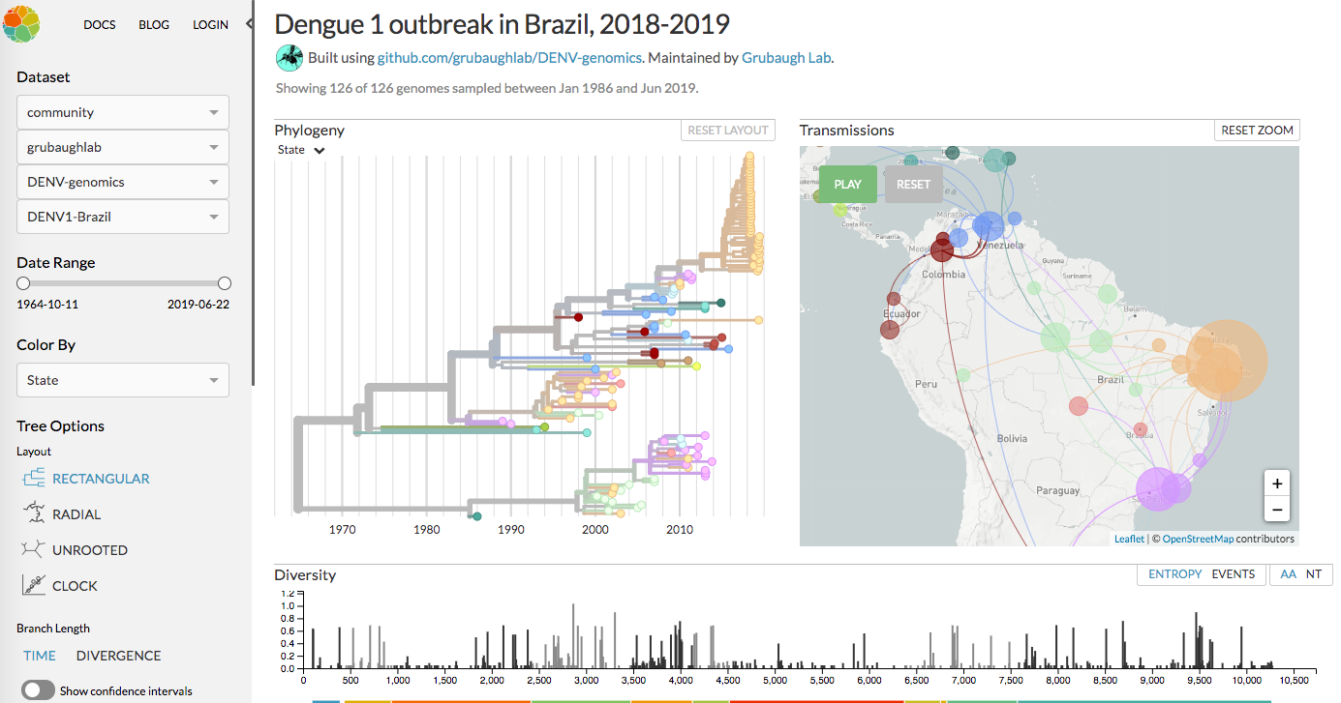

Slide 14
Nextstrain components

Slide 15
Augur
Modular phylogenetic analysis workflow
Ran using workflow manager (snakemake)
Documentation:
https://nextstrain.org/docs/bioinformatics/introduction-to-augur
Teaching notes:
https://neherlab.org/teaching_notes/201909_Emma_augur_steps.pdf

Slide 16
Augur
Input data
sequences.fasta
metadata.tsv
Can also import a tree if already constructed (like a Bayesian tree)
Visualization data for Auspice
Colors, lat_longs, reference genome

Slide 17
Augur
What augur does
Prepare pathogen sequences and metadata
Align sequences
Construct a phylogeny from aligned sequences
Annotate the phylogeny with inferred ancestral pathogen dates, sequences, and traits
Export the annotated phylogeny and corresponding metadata into auspice-readable format (JSON)

Slide 18
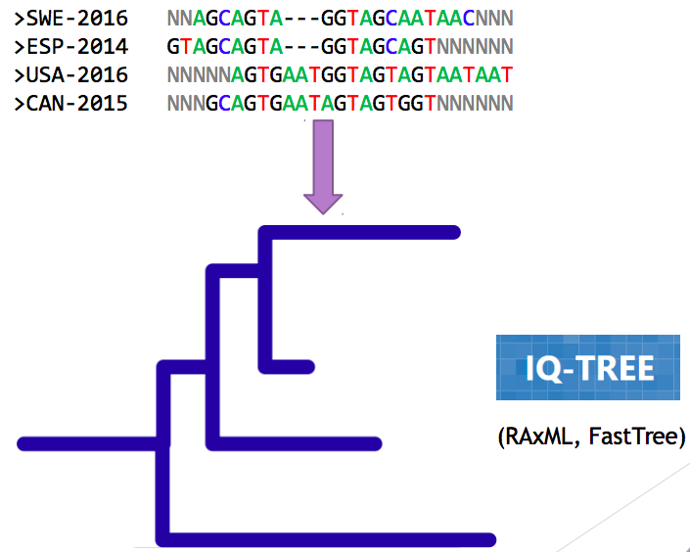
Nextstrain phylogenetics
IQ-TREE
Maximum-likelihood (ML); Fast

Slide 19
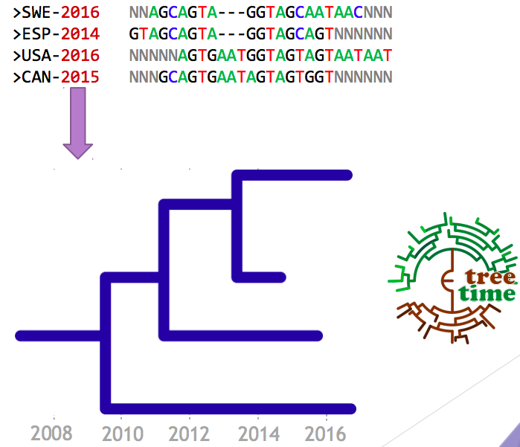
Nextstrain phylogenetics
IQ-TREE
Maximum-likelihood (ML); Fast
TreeTime
Also ML – much faster than Bayesian!
What it does:
estimate ancestral states
infer evolution models
reroot trees to maximize temporal signals
estimate molecular clock phylogenies
estimate population size histories
You can use TreeTime independently
https://github.com/neherlab/treetime
https://treetime.biozentrum.unibas.ch/

Slide 20
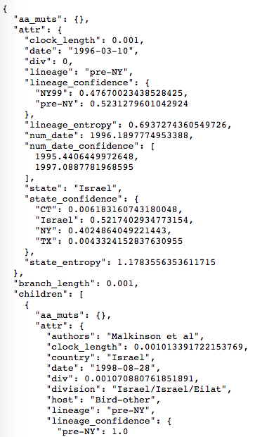
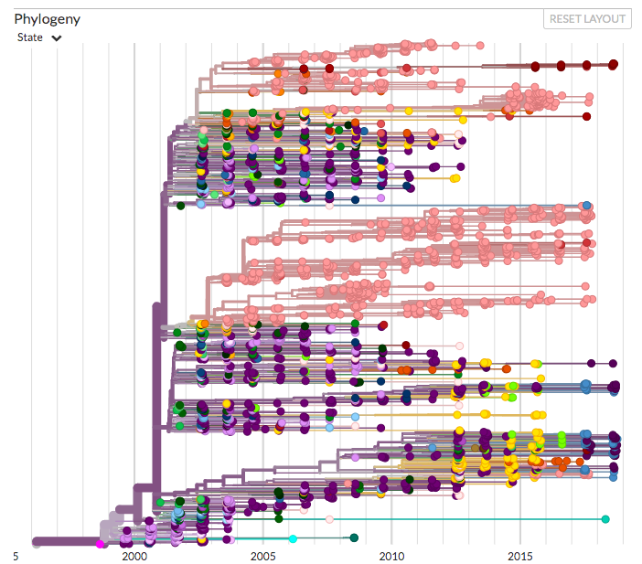
Auspice
Interactive web-app for visualization
Uses JSONs (JavaScript) to transmit data into web applications
meta.json (from Augur)
tree.json (from Augur)
auspice_config.json

